Slide 1


VISVESVARAYA TECHNOLOGICAL UNIVERSITY JNANASANGAMA, BELAGAVI-590 018
Final Project Progress Report on
VEHICLE SUPPORT SYSTEM
Submitted in partial fulfillment for the award of degree of
Master of Computer Applications
Submitted by
ABHISHEKA B
4VZ16MCA01
Project Carried out
at
VTU PG CENTER
Hanchya, Sathagalli Ring Road,
Mysuru-570029.
Internal Guide
Prof. SOWJANYA M N
Assistant Professor
VTU PG Center, Mysuru.

Slide 2
FUTURE ENHANCEMENT
In future the system can be extended by adding modules like medical, food and so forth, for providing services like medical emergency and food supply etc. So that by adding these module the system will become more useful and by using the system the peoples can reduce their time and effort.
Contents
Introduction
Literature Survey
System Requirement
Approach adopted
Architecture Design
Detailed Design
Modules
Screen Shots
Conclusion
Future Enhancement
Bibliography

Slide 3
Introduction
"Vehicle Support" system comprises of android applications created on java platform, namely
* Vehicle Service, and
* Vehicle Mechanic
Aim:
Provide services to the public or customer who is in need of a mechanic in their location by providing location visibility to both mechanic and customers through applications.
Features:
* Customer and Mechanic can maintain their profile.
* Find’s the mechanic nearest to customer’s location.
* Provide direction between the mechanic and the customer.

Slide 4
…Continue
Scope of the project:
The main scope of the project is to find a repairman who is nearest to the location of the public or customer who is in need of a repairman and provide location perceivability to get monitoring each other.
Objectives:
* To design and develop android application to provide services to the user who are in need of a mechanic.
* To provides simple and easy user interface.
* To make effective use of The Google services.
* To provides easy way for both the user and the mechanic to locate each other.

Slide 5
Literature Survey
Existing System:
There is no current android application which gives area perceivability to the clients and mechanics. The Google will provide the location details of the mechanics who are all nearer to customer but it would not provide other details like weather the mechanic had started or not, how much time may require to reach the customer and so forth.
Disadvantages of Existing system:
* The Google will only provide the basic information about the Garages or Mechanic to the Customer.
* The Google will not provide details about the mechanic like weather the mechanic is available or not.
* It will not show the location of the customers to the mechanics.
* Even it shows the location of the mechanic to the customer, it won’t show the directions.

Slide 6
…Continue
Proposed System:
In the proposed Vehicle Support system, the data about the Mechanic will be noticeable to the client and the area of the client will be unmistakable to the technician. The project gives a simple route to the general population or client to locate the specialist close to him and get the administration as conceivable as quick since technician give benefits in the client area.
Advantages of Proposed system
* At the point when there is a requirement for technician, the application will give an effective method to discover and get administration, especially when the client is new to that place.
* Use of this application will incredibly decrease time.

Slide 7
Hardware and Software Requirements
Hardware Requirements:
Processor : Pentium Dual Core.
Memory space : 8 GB and above
Monitor : 15’’ LED
Input Devices : Keyboard, Mouse
RAM : 1 GB
Software Requirements:
Development Environment : Android Studio
Programming Language : Java
Operating System : Windows 8, Windows 7(Minimum)
Android Version : API Level 17 and above
Database : Firebase realtime database

Slide 8
Approach Adopted
Iterative waterfall model
Feasibility study
RequirementzAnalysis
SystemzDesign
Implementationz
Testingz
Deployment
Maintenancez

Slide 9
Software Requirement Specification
Users
* Admin
* Mechanic
* Public or Customer
Admin :
Admin is in charge of dealing with the clients and mechanics who are altogether enlisted to the system through web and the Admin is not interact with the system through the application.

Slide 10
Public :
Public who needs to get organization through the application should be register and logged in.
Exactly when there is a necessity for the expert, the customer should give some principal nuances like sort of vehicle, etc to get the administration.
Mechanic :
Specialist who is interested to serve through the application should be enlisted to the application and should agree to the terms and conditions of the system.
At the point when there is a request for an administration he ought to give administration to the client by achieving the client area.

Slide 11
System Design
System perspective
Android Device
Server
Realtime database
Client / Presentation tier Middle tier Data tier
Architecture

Slide 12
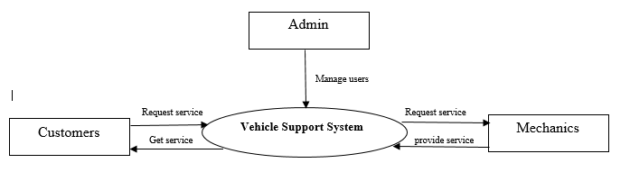
…Continue
Context Diagram:

Slide 13
Detailed Design
Use Case Diagrams
Register
Register
Login
Login
Select Vehicle Type
Select Vehicle Type
Maintain profile
Maintain profile
Change Status
Request service
Get service Request
Rating
Provide service
Logout
Logout
Mechanic Use case Diagram
Customer Use case Diagram

Slide 14
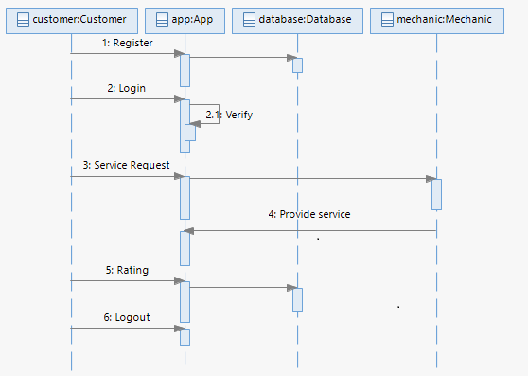
Sequence Diagrams
Customer Sequence diagram

Slide 15
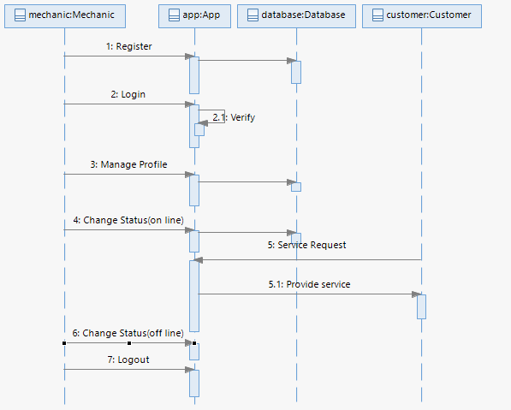
Mechanic Sequence diagram

Slide 16
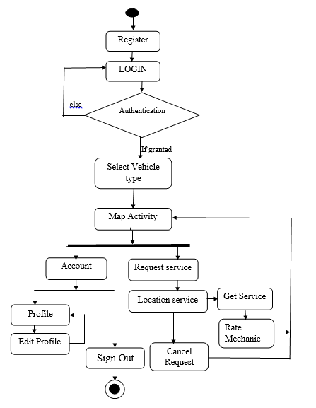
Activity Diagram
Activity diagram for Customer

Slide 17
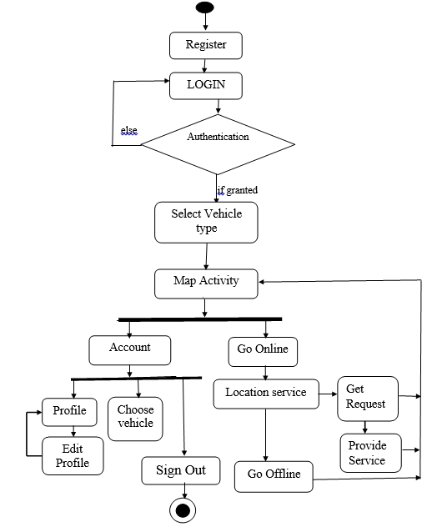
…Continue
Activity Diagram
Activity diagram for Mechanic

Slide 18
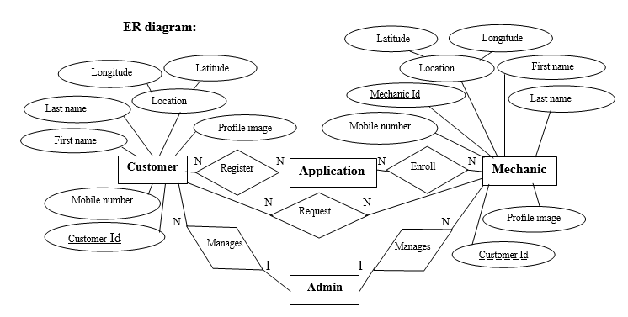
…Continue
ER Diagram

Slide 19
Implementation
Customer module
Registration and login
Vehicle selection
Profile
Request and map
Rating
Mechanic module
Registration
Login
Vehicle selection
Profile
Go online and map

Slide 20
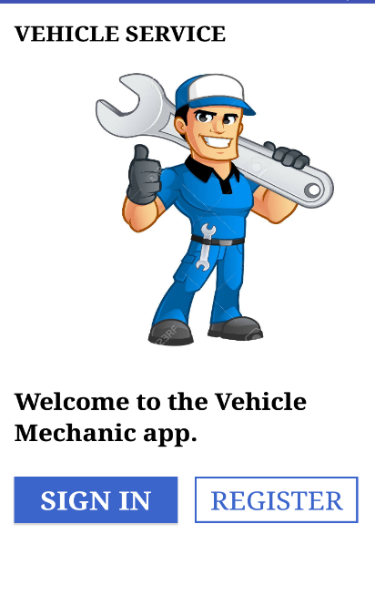
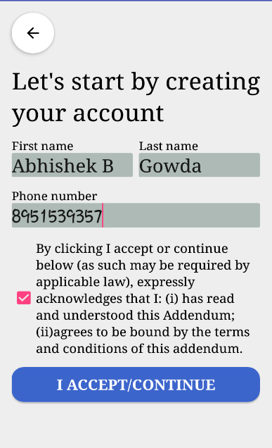
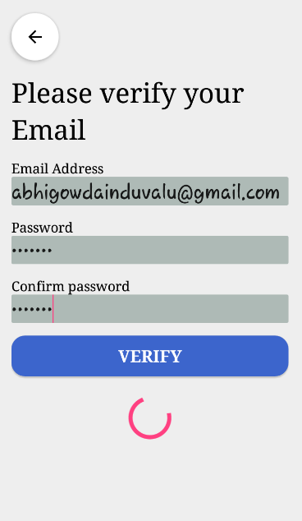
Screen shots
“Vehicle Mechanic” Application
Fig 1. Starting page
Fig 2. Registration page 1
Fig 3. Registration page 2

Slide 21
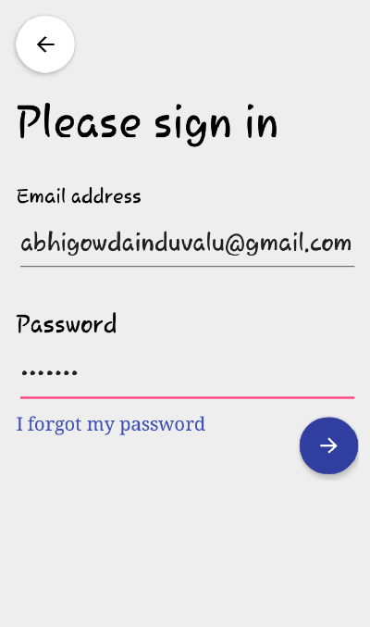
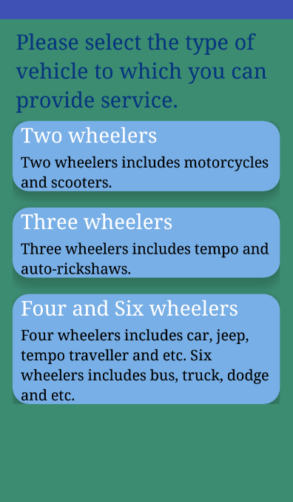
Fig 4. Login page
Fig 5. Vehicle selection page

Slide 22
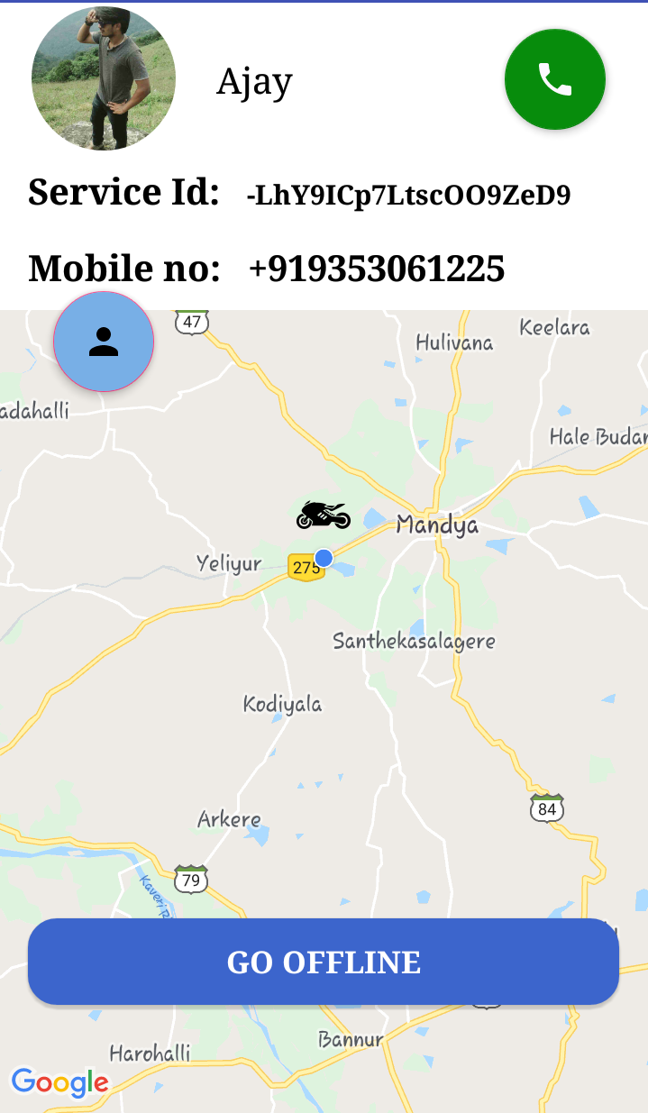
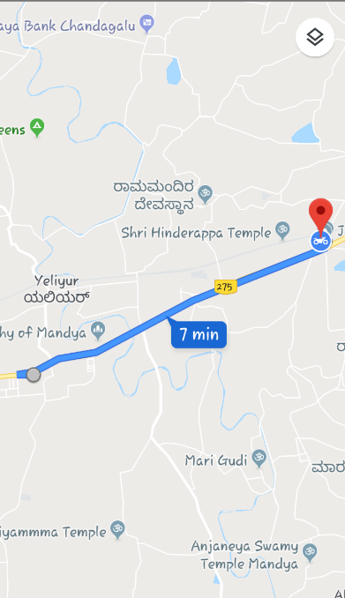
Fig 6. Map page with customer request
Fig 7. Map with direction

Slide 23
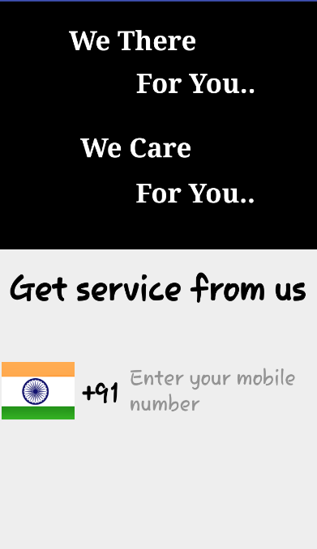
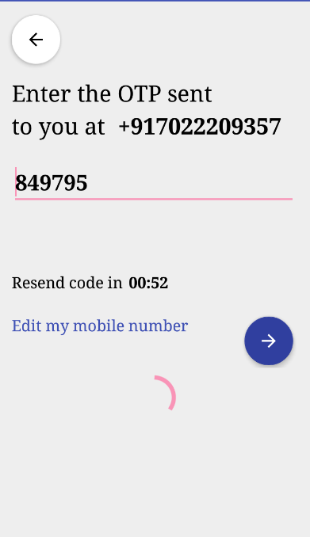
“Vehicle Service” Application
Fig 8. Starting page
Fig 9. Verification page

Slide 24
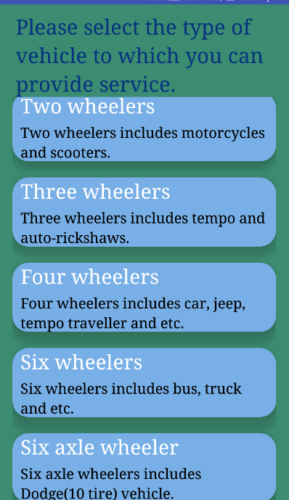
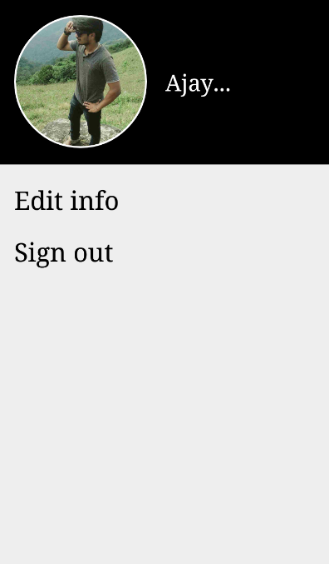
Fig 10. Vehicle selection page
Fig 11.Customer account page

Slide 25
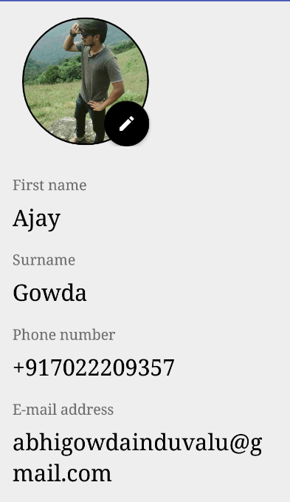
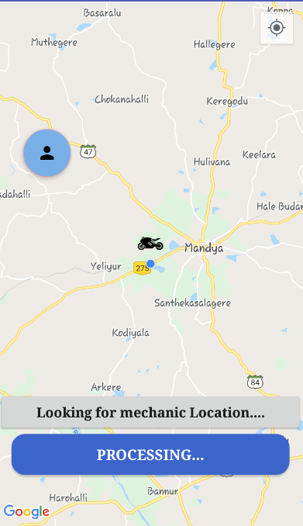
Fig 13. Request page
Fig 12. Edit profile page

Slide 26
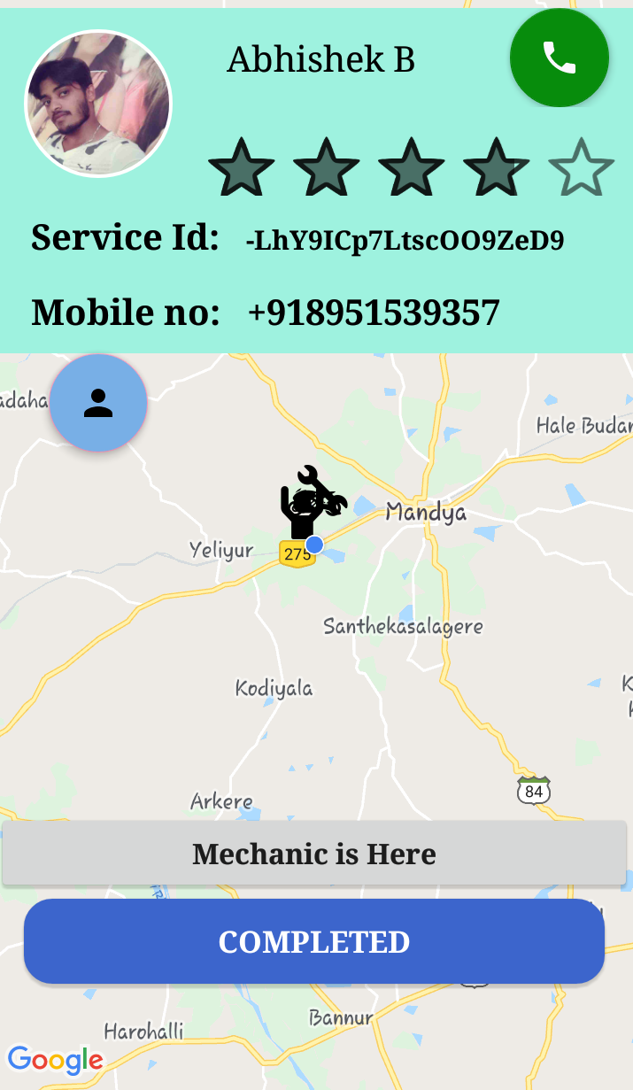
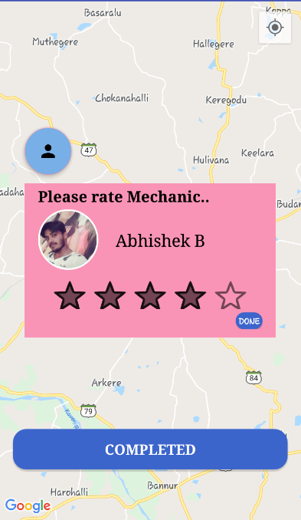
Fig 15. Rating page
Fig 14. Map page after mechanic found

Slide 27
Test Case Number | Testing Scenario | Expected Result | Actual Result | Result
 | Testing for “Vehicle Mechanic“ Application
 | Registration Testing
TC – 01 | Internet connect lost at any stage throughout the process. | “Something went wrong.” Message should display. | “Something went wrong.” Message is displayed. | Pass
TC – 02 | Clicking “Accept/Continue” without entering all fields. | "Please fill all the fields." Message should display. | "Please fill all the fields." Message is displayed. | Pass
TC – 02 | Entering invalid mobile number. | “Enter valid phone number.” Message should display. | “Enter valid phone number.” Message is displayed. | Pass
TC – 04 | Verification code not received within given time. | "Did you entered the correct mobile number?" Message should display. | "Did you entered the correct mobile number?" Message is displayed. | Pass
TC – 05 | Mismatch between password and confirm password fields. | "Password not matched." Message should display. | "Password not matched." Message is displayed. | Pass
TC – 06 | When all the fields are entered with the valid values and click on register | Mechanic should registered and all the details should be stored in database | Mechanic is registered and all the details are stored in database
Software testing

Slide 28
 | Login Testing
TC – 07 | Clicking submit without entering login details | "Please enter the fields." Message should display. | "Please enter the fields." Message is displayed. | Pass
TC – 08 | Trying to login without click on the link sent to the email address given during registration. | "Please check your email for verification link." Message should display. | "Please check your email for verification link." Message is displayed. | Pass
TC – 09 | Trying to login with invalid email Id and password | “Please register if you are not yet registered.” Message should display. | “Please register if you are not yet registered.” Message is displayed. | Pass
TC – 10 | Trying to login with valid email address and password after clicking on the verification link sent to the email address given during registration. | Should go to the vehicle selection activity. | Gone to vehicle selection activity | Pass

Slide 29
 | Testing for “Vehicle Service” Application
 | Registration and Login Testing
TC – 10 | Clicking next without entering mobile number. | "Enter valid phone number." Message should display. | "Enter valid phone number." Message is displayed. | Pass
TC – 10 | Entering invalid mobile number. | “Enter valid phone number.” Message should display. | “Enter valid phone number.” Message is displayed. | Pass
TC – 11 | Verification code not received within given time. | "Did you entered the correct mobile number?" Message should display. | "Did you entered the correct mobile number?" Message is displayed. | Pass
TC – 12 | If Verification is successful. | Should go to Vehicle selection activity. | Gone to vehicle selection activity. | Pass

Slide 30
CONCLUSION
"Vehicle Support" system contains android applications made on java stage and comprises of two android applications, in particular Vehicle Service and Vehicle Mechanic.
The "Vehicle Service" android application will gives a fair User Interface to the customers who are need of administration to their vehicle and to get the administration from the Mechanic nearest their territory.
The "Vehicle Mechanic" is an android application and particularly for Mechanics to offer administration to nearest customer who need administration.
By utilizing the system client can decrease the time and effort to locate the repairman and a technician can improve his business by making himself available at the client's area.

Slide 31
FUTURE ENHANCEMENT
In future the system can be extended by adding modules like medical, food and so forth, for providing services like medical emergency and food supply etc. So that by adding these module the system will become more useful and by using the system the peoples can reduce their time and effort.

Slide 32
BIBILOGRAPHY
Reference websites
https://developer.android.com/docs
www.stackoverflow.com
https://www.youtube.com/watch?v=c-7sW6UJHw0
https://developer.android.com/training/location
https://developer.android.com/guide/topics/location
https://www.tutorialspoint.com/android/android_location_based_services.htm
https://blog.teamtreehouse.com/beginners-guide-location-android
https://firebase.google.com/docs/auth/android/phone-auth etc.
Reference Book
“Professional Mobile Application Development” by Jeff McWherter and Scott Gowell.
“Beginning Android Application Development” by Wei-Meng Lee.

Slide 33
Thank You

